Slide 1



Online Employee Leave System
Submitted by-
Sudeshna saha(11501016005)
Guided by -
Puja basak (Project coordinator of Techtree Technologies)

Slide 2
Online Employee Leave System
Submitted by-
Sudeshna Saha(11501016005)
Guided by -
Puja Basak (Project coordinator of Techtree Technologies)

Slide 3

Contents
INTRODUCTION
OBJECTIVES
HARDWARE & SOFTWARE USED
STUDY OF THE SYSTEM
ADMIN INTERFACE
EMPLOYEE INTERFACE
SYSTEM LAYOUT

Slide 4
Introduction
In most of the organization, each employee has been provided with a leave card at the time of appointment. Leave card shows the leave credited to the employer’s account. This paper based process is time consuming and also causes discrepancies in the record.
Due to the inconvenience in managing the data using leave cards , it is required to have an online Android Application system where employee can login and apply for the leave according to the organization’s norms.

Slide 5
objectives
The aim of this project is to develop an application which enables you to get the status of the leave and to apply for leave.
This system can be used to automate the workflow of leave applications and their approval.
The project will run through online.
The periodic creation of leave is also automated(list view,auto refresher)

Slide 6
Hardware & software used
Processor : Intel core i5
RAM : 4GB
Operating System : Windows 8.1
Technology : Android
Front end: Android (java,xml)
Backend: php-MySql
IDE :Android Studio 3.3.2
Web Server : catfish
Database : Oracle 10g XE

Slide 7

STUDY OF THE SYSTEM
To provide flexibility to the users(employee), the interfaces have been developed that are accessible through an ANDROID Application. The GUI’S at the top level have been categorized as:
Admin Interface
Employee Interface

Slide 8

Admin interface
The initial step which is handled by the admin module is to create an unique user account for each employee.
This module handles the registration process of the employee.
Admin can add, delete, view employee details.
Admin can approve and reject the employee leaves.

Slide 9

Employee Interface
An employee can visit all leave description details once they logged in into the application with the help of id which was provided by the company.
Based on the availability of leave, employee can apply leave.
By the help of this application the employee can view their leave status that it is approved, rejected or pending

Slide 10
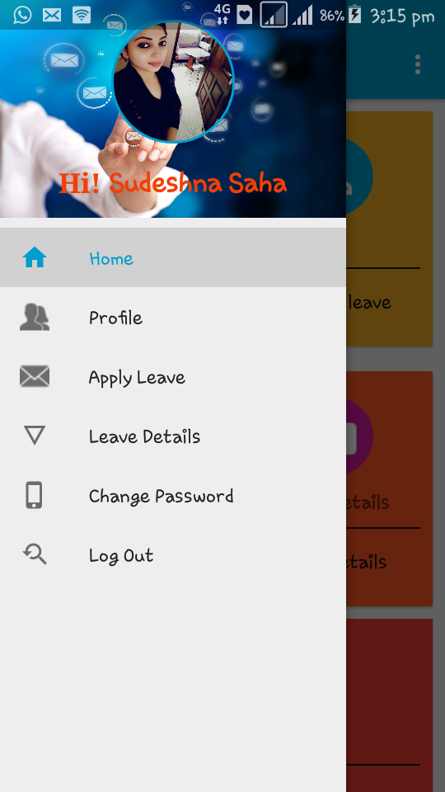
System layout
After careful analysis the application system has been
identified to have the following modules:
Employee log in
Home
Employee profile
Apply leave
Leave details
Sign-out Module

Slide 11
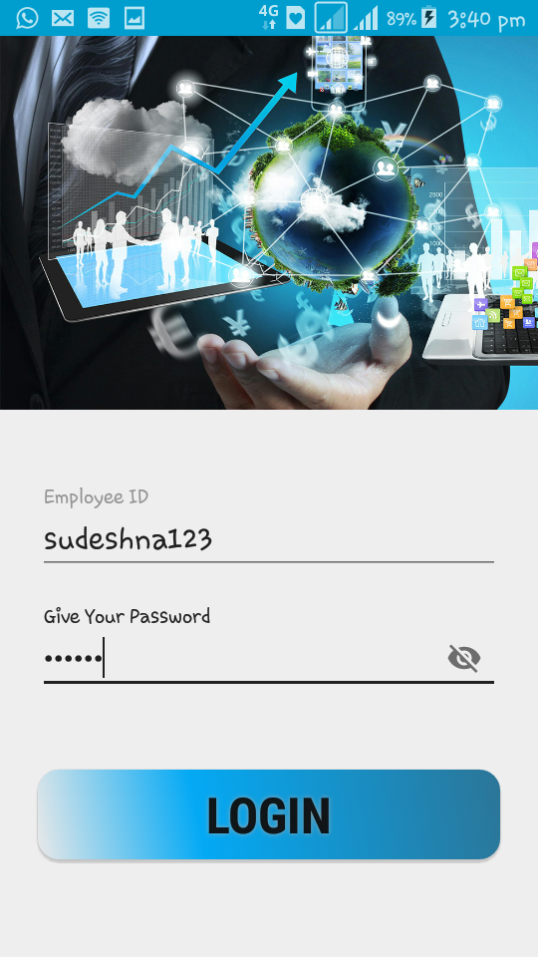
Employee login
Employee can login with the help of login id
and password which was generated by the admin.
If the employee has given the correct login
information they can access the App,
other wise it will show error message.

Slide 12
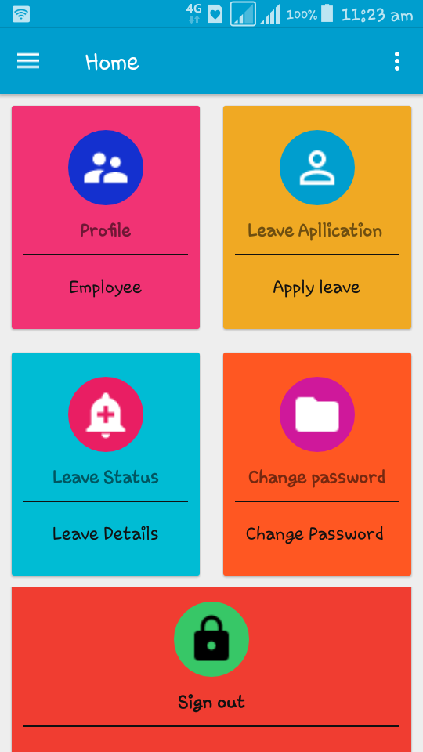
Home
It is basically a static page
It will display the basic flow of this application

Slide 13
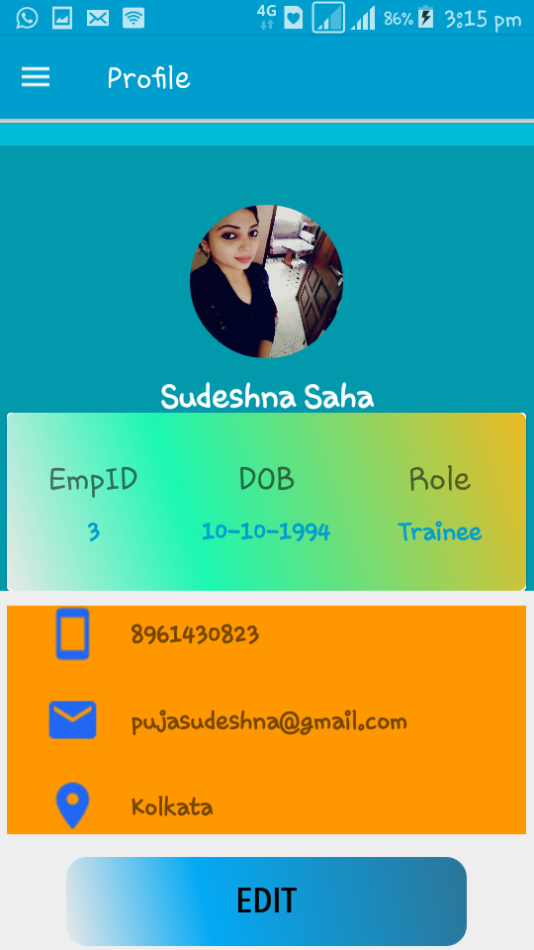
Employee profile
This module displays all the information
related to a particular user(employee).
From the navigation drawer if an employee
choose ‘Profile’ option it will display the
detailed information for a particular employee.
In hence it will be the passed the session of an
employee using login id.
One can edit his/her profile by using edit button
The detailed information has stored into company’s data base.
By using JSON Parser it has fetched the data from
data base through an API.

Slide 14
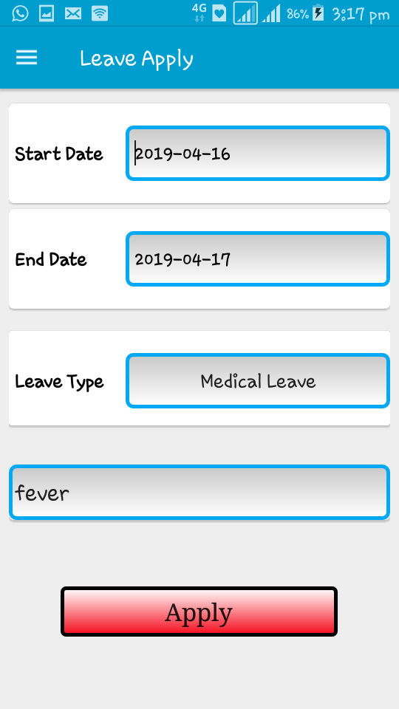
Apply leave
This module provides functionalities that allow
the employee to apply leave.
Maximum 15 leaves can be applied by an employee
The apply leave balance will be shown as a warning
message
If you choose ‘yes’ option then you may apply to proceed
further
An employee can apply a leave on day to day basis
(fromdate-to_date)and then the information
will be going to the backend part.

Slide 15
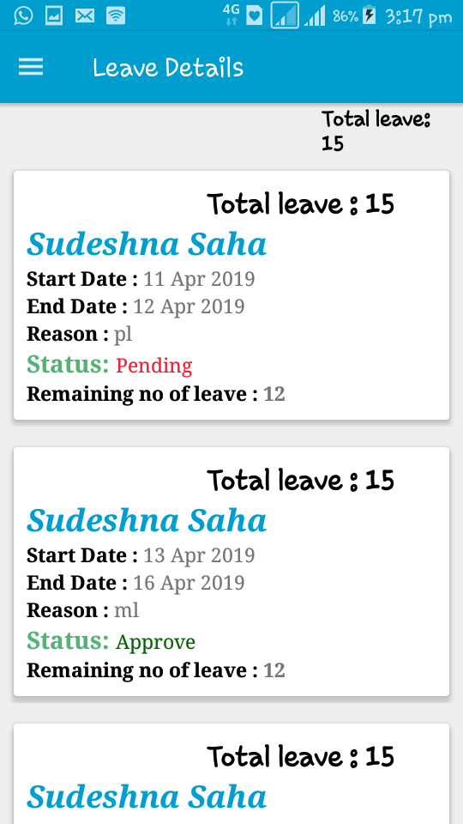
leave Details
This module gives the list view of all detailed leaves
which has applied by an employee
By default it will show ‘Pending’ status,
once it will be approved
by the admin, it will display ’Approved’ status.

Slide 16
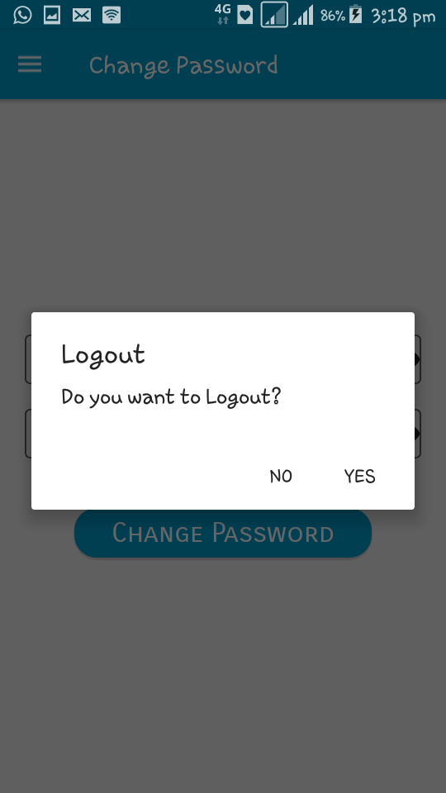
Sign out module
Once an employee completed their task ,by tapping
‘Logout’ option from navigation drawer,
it will be showing you an alert dialog box
If you choose ‘yes’ it will be redirected
to the login page.

Slide 17
conclusion
Provides a customized view of an online android application to the employee.
The app is easy and flexible to handle the leave system
Better UI-design
Employee can edit his/ her details, also they can change the password, which was given by the organization.
User interactive view of leave details
Leave balance will b e shown as a warning message in leave application page.

Slide 18


Thank You

